Slide 1
CSS Selectors:
Select by Class

Slide 2
Recap

Slide 3
General Format for CSS Rule
selector {
property: value;
property: value;
…(as many declarations as you want)
}

Slide 4
CSS Selectors
selector {
property: value;
property: value;
…(as many declarations as you want)
}
The selector defines which HTML elements this rule applies to

Slide 5
Select by tag
h1 {
font-size: 60px;
color: red;
}
This rule applies to all <h1> elements

Slide 6
Select by tag
p {
font-size: 60px;
color: red;
}
This rule applies to all <p> elements

Slide 7
NEW: Select by Class
.alert {
font-size: 60px;
color: red;
}
This rule applies to all HTML elements with the class “alert”

Slide 8
The class attribute
class is an attribute we can add to HTML tags in order to style a specific group of elements

Slide 9
The Class Attribute
<p>Hello</p>

Slide 10
The Class Attribute
<p class=“alert”>Hello</p>
This sets the class attribute of the <p> tag to be “alert”

Slide 11
The Class Attribute
<p class=“alert”>Hello</p>
<a class=“alert” href=“#”>Click Me</a>
<h1 class=“alert”>HI!</h1>
Different types of tags can all have the same class

Slide 12
Selecting by Class
.alert {
font-size: 60px;
color: red;
}
This rule applies to all HTML elements with the class “alert”

Slide 13
Selecting by Class
.alert {
font-size: 60px;
color: red;
}
The name of the class is preceded by a period .

Slide 14
Selecting by Class
p.alert {
font-size: 60px;
color: red;
}
This rule applies to only <p> elements with the class “alert”

Slide 15
Selecting by Class
h1.alert {
font-size: 60px;
color: red;
}
This rule applies to only <h1> elements with the class “alert”

Slide 16
Multiple Classes
<p class=“alert large”>Hello</p>
This <p> tag has 2 classes: “alert” and “large”
Separate class names with spaces.
Both the “alert” style and “large” style will apply

Slide 17
Class names
Cannot have spaces
Cannot start with a number

Slide 18
Class names
class=“2large”
class=“large font”

Slide 19

Class names
class=“2large”
class=“large font”

Slide 20
Class names
class=“large2”
class=“large-font”

Slide 21

Class names
class=“large2”
class=“large-font”

Slide 22
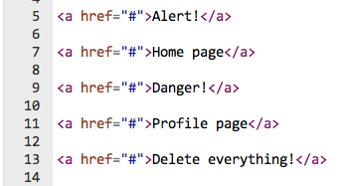
Example: Styling Links
<style>
a {
color: blue;
}
</style>

Slide 23

Example: Styling Links
<style>
a {
color: blue;
}
</style>

Slide 24
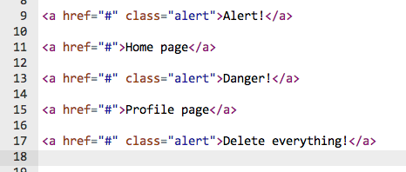
Example: Styling Links
<style>
a {
color: blue;
}
</style>

Slide 25
Example: Styling Links
<style>
a {
color: blue;
}
</style>

Slide 26
Example: Styling Links
<style>
a {
color: blue;
}
.alert {
color: red;
font-size: 20px;
}
</style>

Slide 27
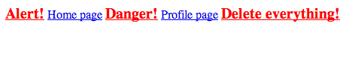
Example: Styling Links
<style>
a {
color: blue;
}
.alert {
color: red;
font-size: 20px;
}
</style>

Slide 28
Class overrides Tag
class style overrides tag style in the case of a conflict
class is considered to be more specific
Any <a> tag with the class “alert” will be red instead of blue
<style>
a {
color: blue;
}
.alert {
color: red;
font-size: 20px;
}
</style>

Slide 29
Let’s see this in the editor!

